Slide 1
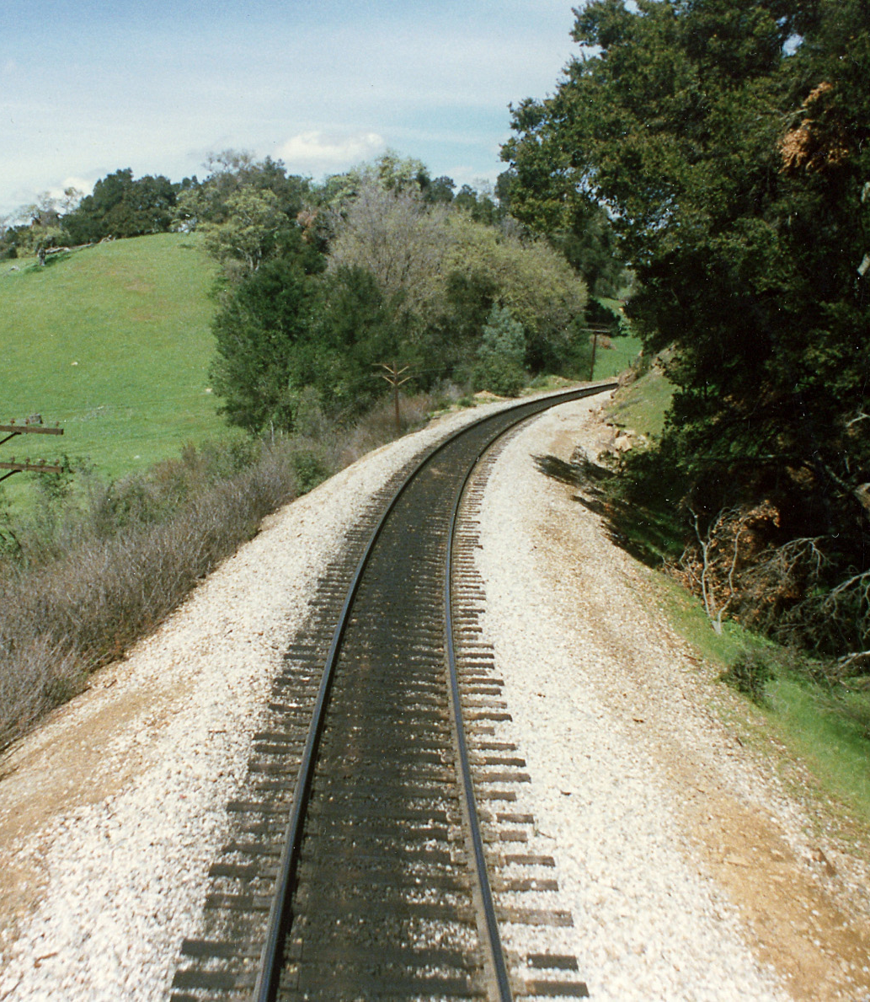
Travel
By train

Slide 2
Animation

